Slide 1
Chapter6 (Lecture2)
Structuring System Requirements: Process Modeling

Slide 2
Use Cases
Step 1 Identify the actors
As we read the scenario, define those people or systems that are going to interact with the scenario.
A patient calls the clinic to make an appointment for a yearly checkup. The receptionist finds the nearest empty time slot in the appointment book and schedules the appointment for that time slot. "

Slide 3
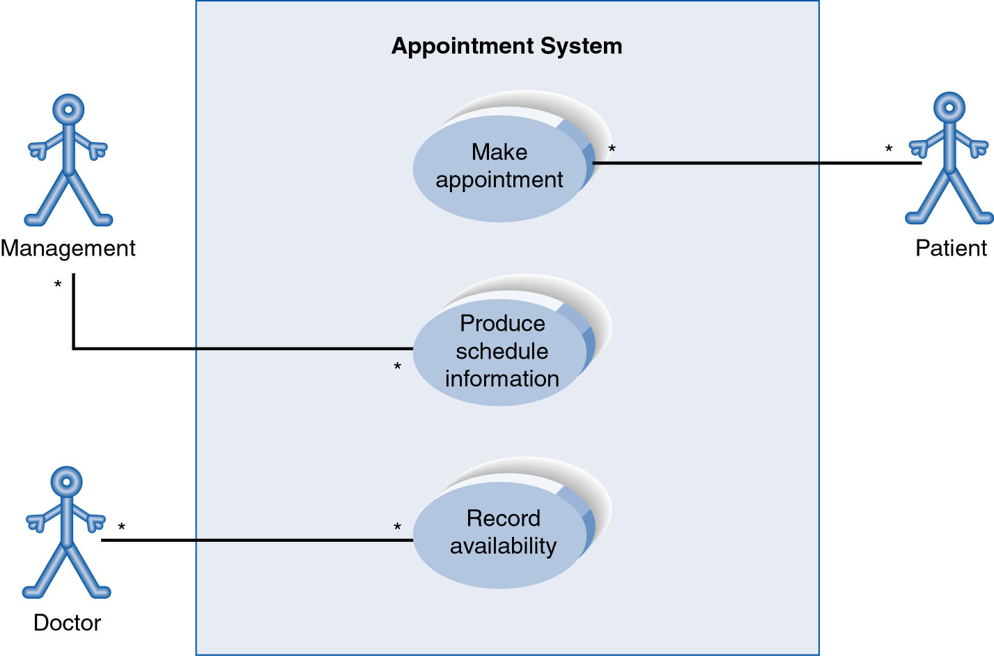
Use Case Diagram for Appointment System
A use case diagram is a collection of actors, use cases, and their communications.
Notes:
Example Use Case
ACTORS
Represented by a stick figure
named
USE CASE
Represented by an oval
Named (POORLY NAMED; should be verb phrase)
RELATIONSHIP
2-way association

Slide 4
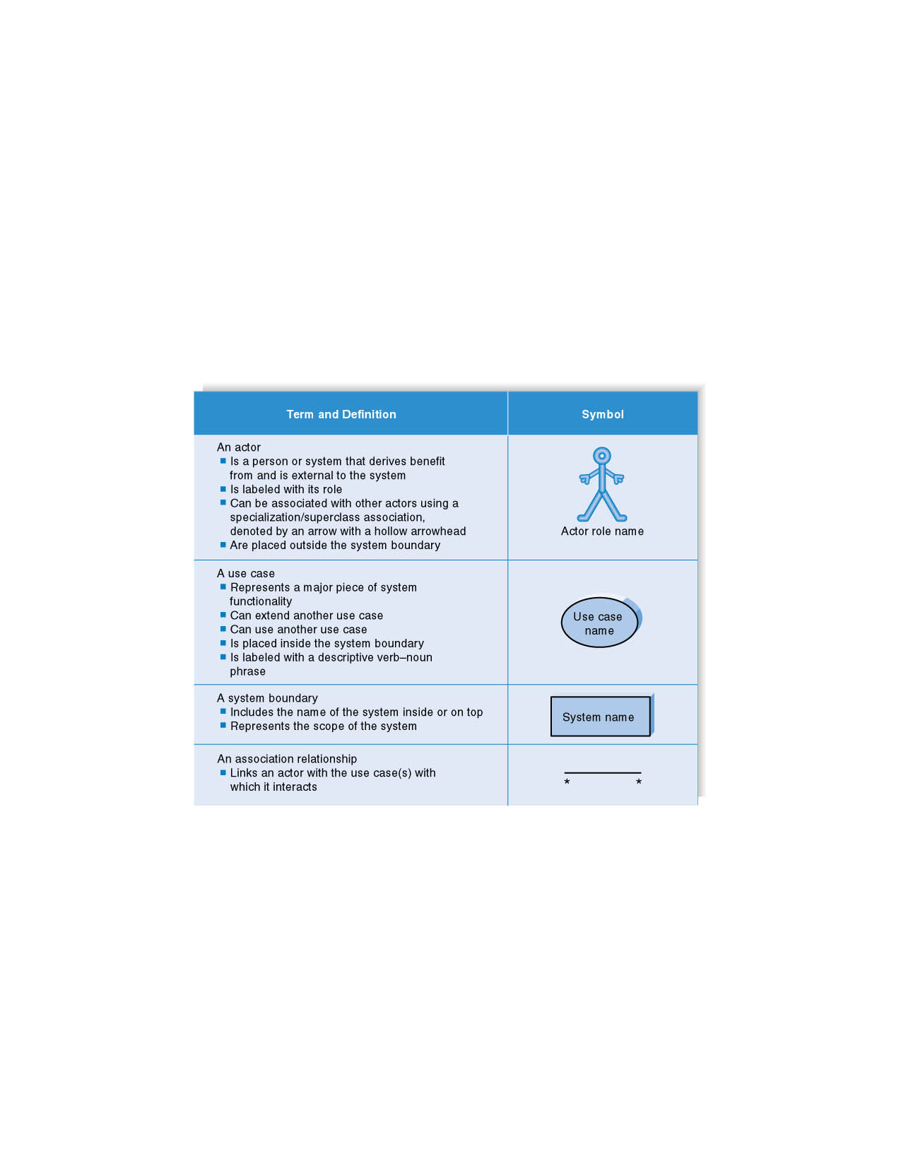
Syntax for Use Case Diagram

Slide 5
Use-Case Diagrams
Association:
communication between an actor and a use case; Represented by a solid line.
Generalization: relationship between one general use case and a special use case (used for defining special alternatives) Represented by a line with a triangular arrow head toward the parent use case.
Notes:
Association اتحاد
Generalization تعميم

Slide 6
Use Case Diagram
Other Types of Relationships for Use Cases
  Generalization
  Include
  Extend
Notes:
Inheritance

Slide 7
Components of Use Case Diagram
Generalization Relationship
  Represented by a line and a hollow arrow
    From child to parent
Child use case
Parent use case
Notes:
Inheritance
A use case generalization shows that one use case is simply a special kind of another.
A clinic may have a use case such as Pay Bill which would be a parent use case and Bill Insurance which is the child.
A child can be substituted for its parent whenever necessary.
Generalization appears as a line with a triangular arrow head toward the parent use case.

Slide 8
Use Case Diagram
Include Relationship
  Represents the inclusion of the functionality of one use case within another
  Arrow is drawn from the base use case to the used use case
  Write << include >> above arrowhead line
Notes:
Include relationship
Notice that ONLY between use cases (not between actors)
MANDATORY functional
Multiple use cases may share pieces of the same functionality
Rather than have duplicate functionality in several use cases
Put shared functionality in one use case and show relationship between it and other use cases that “uses” its functionality
Depicted by arrowhead with word “<<include>>” above it
Include relationships factor use cases into additional ones.
Includes are especially helpful when the same use case can be factored out of two different use cases.
If a clinic had a cases of Make Appointment and Request Medication.
Both might include Check Patient Record as a subtask.
Both would include a call to the use case Check Patient Record.
We don’t want to write it twice we simply want to include in as a call from both.
In the diagram,
include notation is a dotted line beginning at base use case ending with an arrows pointing to the include use case.
The dotted line is labeled <<include>>.

Slide 9
Use Case Diagram
Extend relationship
  Represents the extension of the use case to include optional functionality
  Arrow is drawn from the extension use case to the base use case
  Write << extend >> above arrowhead line
Notes:
Use Case Relationship
Extend relationship
Used to show optional behavior (behavior that is run only under certain circumstances)
Depicted by arrowhead with word “<<extend>>” above it
An extend relationship indicates that one use case is a variation of another.
This is often used when much of the same code may be in both only one extends the functionality somewhat.
A typical example is a add record to the database and modify that record.
So an add student is similar to a modify student so I may reuse some of the code.
Extend notation is a dotted line, labeled <<extend>>, and with an arrow toward the base case.
The extension point, which determines when the extended case is appropriate, is written inside the base case.

Slide 10
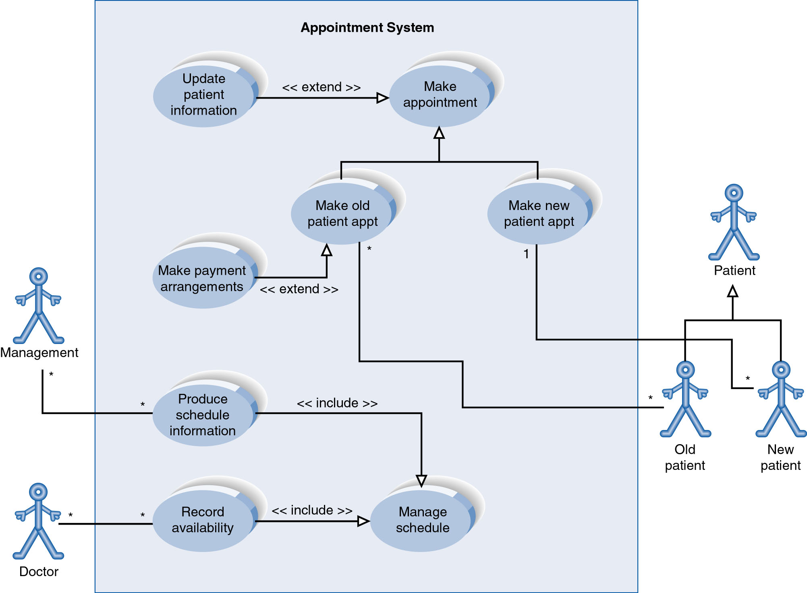
Example of Relationships
Notes:
System Boundary
Use cases are enclosed within a system boundary
a box that represents the system and clearly delineates what parts of the diagram are external or internal to it
Name of the system can appear inside or on top of the box

Slide 11
Use Case Relationships
Pro:
  Reduces redundancy in use cases
  Reduces complexity within a use case
Con
  May introduce complexity to use case diagram
Notes:
Mainly talking about extend, include, and generalization relationships.
95% of relationships on a use case diagram is association

Slide 12
Benefits of Use Cases
* Use cases are the primary vehicle for requirements capture
* Use cases are described using the language of the customer.
* Use cases provide an easily-understood communication mechanism.
* When requirements are traced, they make it difficult for requirements to fall through the cracks
* Use cases provide a concise summary of what the system should do at an abstract (low modification cost) level.
Notes:
Traced تتبع
Cracks تشقق

Slide 13
Thank You
Notes:
5
5

